Slide 1

MTD: MOOD TOOLKIT DASHBOARD A Data Analytical Web Application for Psychological Research Studies
Master’s Project Defense
By: Dheeraj P. Srivatsav
Advisor: Dr. Yi Shang

Slide 2
OUTLINE
Introduction
Related Work
Design & Implementation
Results
Conclusion & Future Work
Notes:
Introduction --- Problem. Solution. Overview of the App
Conclusion --- Conclusion, References

Slide 3
OUTLINE
Introduction 1. Problem Description 2. Proposed Solution 3. Web Application Dashboard Overview
Related Work
Data Overview
Methodology & Implementation
Results
Conclusion

Slide 4
Introduction
Mood Toolkit
Ambulatory Assessment
SLU WATCH
Alcohol Craving
Notes:
Motivation.. Why do this??
give some background
A currently successful and highly popular research being undertaken by MU department of psychology
Collect data from apps and analyze build machine learning models and predict and improve treatment and finally better community
What is Mood toolkit doing
What did SLU watch do
How are people working on Alcohol craving data

Slide 5
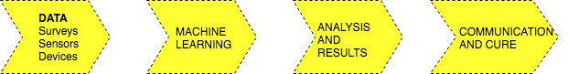
Introduction
Data collected from the apps
High Frequency points of Data, helpful for Researchers
Existing Pipeline
Notes:
Talk about existing pipeline and how it is currently being used.
mAAS and other methods are being employed to optimize collection and storage, some web service implementation.
Refer everyone

Slide 6
Problem
All Survey and Sensor raw data. No application oriented approach
Researchers don’t have easy access to data to make decisions ( compliance, how many days? alarming metrics?)
Data files residing on the server, needs to be accessed and analyzed
Manual calculation of simple metrics and manual graphing
No Visualization or Usage for such data intensive studies
Just excel sheets of high frequency data points
Difficult to find common trends and analyze
Different data sets available which can be used for analysis and building a web based application
Alcohol Craving( Survey and Sensor)
SLU Watch ( Combined)
NIMH ( Survey data)
Notes:
Only BOX account data, not an application oriented approach. You have to access, difficult for researchers
Some researchers like Nick and Li Can have used manual calculation for finding the key metrics and deciding whether to move forward with a record or not. That might be a long process and may be error prone
Bunch of excel sheets, high frequency records, in cases 1row per second
If it was just a one-off dataset, not much motivation, because there are many similar datasets, a huge motivation to combine and congregate the data
All the data is used for ML , yes, but for lower level metrics and providing ease of access should be done to improve the existing pipeline
Help MU department of psychology with data collection and analysis

Slide 7
Proposed Solution
Missing piece of an existing pipeline, which will help the research community
Web Application Dashboard
Providing ease of access( one location, analytics, data, breakdown patient wise). On one server
Modular application. Easy to use, a framework / skeleton available to add/extend studies
Used disparate data sets, showed relationships and presented a hierarchical visualization scheme
A full stack development methodology using industry standard technologies
Use Highcharts.js to draw interactive aesthetic graphs
LAMP Stack for development and AngularJS for front-end
Python for analytics
MVC Architecture
Notes:
Easy to use, Nick’s paper and graph, cite that as a reason
Nick’s paper manual work
Li Can presentation, manual work. For basic calculation, you can use this.
What pipeline?? Something which Luke, Nick, Will and Peng are working on . There is App from Will, there is the cleansing done by Luke, Nick and Peng implement ML and Analysis, so a web front will help in ease of access and create a location for everything at one place
Tell how Tim and others with only surface data also want to analyze this, how it will motivate other users to ask for a module for them too

Slide 8

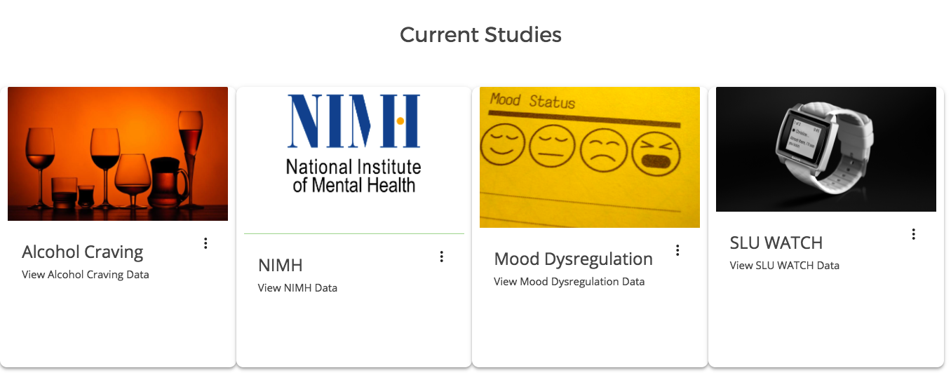
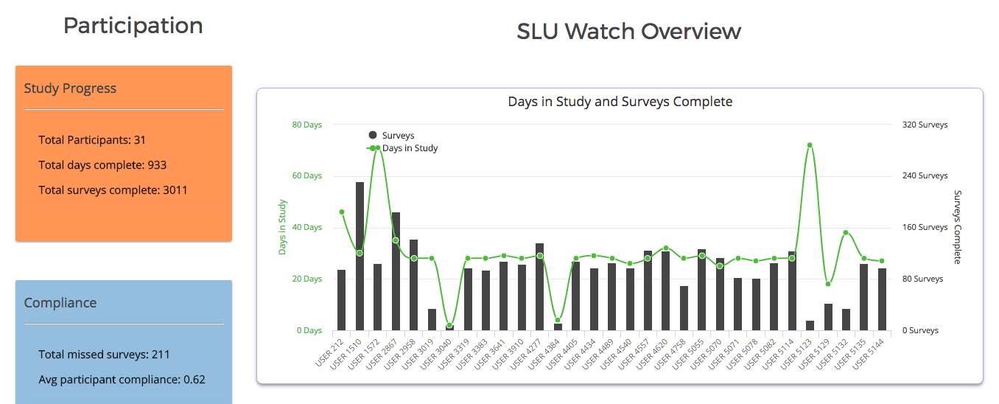
Mood ToolKit Dashboard Overview
Notes:
A web application is one which has 3 components of a business logic DB , GUI and a Web Server
A dashboard shows key metrics which determine research focus and influences business decisions
An application oriented approach using software development techniques allows a good addition

Slide 9
OUTLINE
Introduction
Related Work
Data Overview
Methodology & Implementation
Results
Conclusion

Slide 10
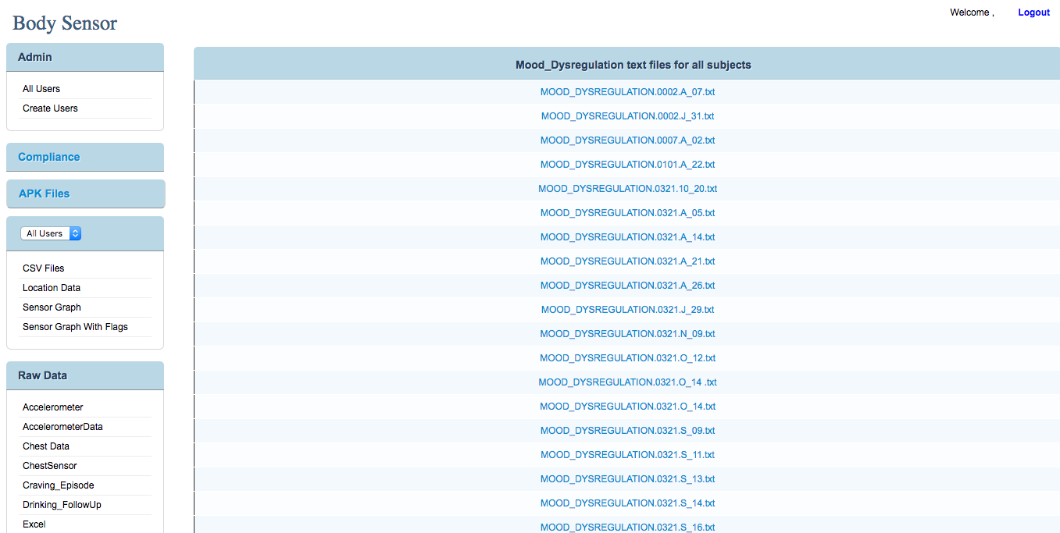
Related Work
As part of mAAS [1]
Helped with understanding data and study
Emphasis on Mobile App, Data storage and Machine Learning
Monolithic Architecture
Single Study
Mostly Text Files not graphs
Flat file system structure
Notes:
A web-based dashboard is a web application that helps in providing multiple views of a large scale dataset. Visualization is a very important functionality
Applications built for research faculty seldom permit end-users to customize the dashboard
Monolithic architecture – No room for change, monotonous and single logic. Just PHP.
Usage of highcharts and modular development architecture overcomes certain drawbacks

Slide 11
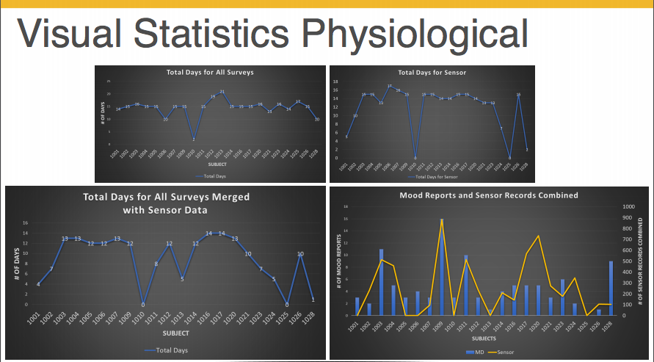
Related Work (cont.)
2. As part of AMD [2]
Also helped with understanding data (NIMH)
Completely into Machine Learning Pipeline
Key analytical metrics were defined which were useful
Notes:
All these graphs were used as part of data collection and cleaning and then decision were made if whether to use it or not
But a readily available application showing key metrics like these would help them make decisions quickly and move on to their part of research
ASK:: Motivation ?? Building data analytical dashboards on a web front using recommended practices and make use existing idle data .
In my case use the rich available frameworks which make building robust, modular web apps by using industry standard and get exposure to new technologies
Key characteristics of such UIs are single-page interface, data loaded on-demand via AJAX, highly modular design, easily interpretable code logic and client-side view generation. MVC arch is an industry standard used in production code

Slide 12
OUTLINE
Introduction
Related Work
Data Overview
Methodology & Implementation
Results
Conclusion

Slide 13


Data Overview
3 different ambulatory assessment studies
SLU WATCH
200 MB for all patients file
700,000 data points
31 participants under study ( sensor data – Frequency 1min)
Survey + Sensor
Alcohol Craving
5 MB all patients file
13,000 data points
24 participants under study ( survey data)
Notes:
Averaged from 1 per second to 1 per minute
DRAW GRAPH indicating all the changes and variations
Input Data overview… HOW THIS WILL BE USED AND WHAT WILL done to this data

Slide 14
Data Overview (Cont.)
NIMH Data
1.5 MB all patient file
5,300 records ( survey data)
33 patients under study
Incorporated to SQL for a structured approach to retrieve data
Aggregation of data to find key points of interest
Files count over 500 had to be cleaned and grouped
Available for download at participant level
Notes:
Each patient has a daily results EXCEL file. Everything had to be zipped at one location so as to ease of access.
Converted SQL results to JSON so that front end mapping is easy

Slide 15
OUTLINE
Introduction
Related Work
Data Overview
Methodology & Implementation
Results
Conclusion

Slide 16
Methodology
WHAT GOES INTO DASHBOARDS
KEY CONSIDERATIONS
TIMELINESS
UI DESIGN
INTERACTIVITY
DATA INTENSIVENESS
ACCESSIBLE DATA
SIMPLE CALCULATION
INTERPRETABLE
IDEAL METRIC
Notes:
KEY CONSIDERATIONS;
STRUCTURE
Show relationships – Multi level views
Provide Grouping of Data – Doesn’t mean everything should be at one place; group based on relationships, group based on metrics.
Timeliness ---- relevant data which is useful
UI – aesthetically pleasing, rich graphs, new technologies
Interactivity – Allow user actions ( download, view individual data, add / delete user)
Intensiveness – small data makes no sense, large sampling means better way to show trends and changes

Slide 17
Web Application Architecture
Components of a Web Application
Front End
Back End
Database
Process
STEP 1 : Application Download
STEP 2 : Presentation Flow
STEP 3: Data Interchange
MTD SYSTEM ARCHITECTURE
LAMP Stack
Software Engineering Approach
Notes:
START OFF WITH A SIMPLE DIFFERENCE BETWEEN WEBSITE AND WEBAPP
PROCESS
Application Download
Mobile code (JavaScript, HTML, Applets, Flash) download to the client (web browser)
Presentation Flow
Dynamic visual rendering of the UI (screen changes, new screens, etc) in response to user input and data state changes
Data Interchange
The exchange of data between two software components or tiers (GET POST DELETE)
EXPLAIN THE ARCHITECTURE OF MTD, Tech Stack ( include Highcharts.js) AND A GENERAL WEB APP DEVELOPMENT PROCESS

Slide 18
Design Considerations
MVC ARCHITECTURAL PATTERN
Model – View – Controller
Industry Standard for implementing UI
AngularJS implementation
2-WAY DATA BINDING
Notes:
KEY INDUSTRY STANDARD
user interface changes completely separate from business logic.
Easier maintenance and testing of code made possible.
Secure as the UI pages will not be have the backend table structures/ other logic involved.
Modular and robust design features as a result, provides extensibility and abstraction support
Explain the difference between conventional 1 way binding and this kind of 2 way binding MV *

Slide 19
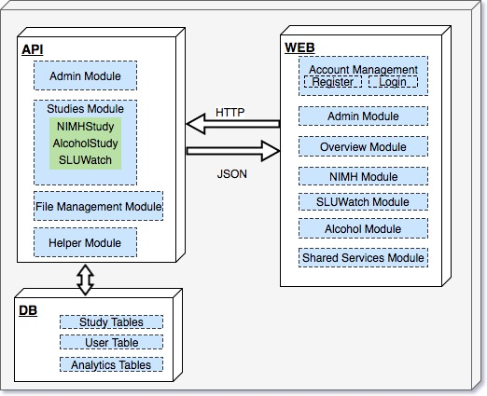
System Implementation
Module Level Architecture Diagram
Notes:
Module level system arch --- Talk how you split up everything into different modules from the high level architecture.
This made development easy
HTTP communication
Db resides on the same server so delay is cut short during requests
Process followed for each study
survey schema generalization
Considerations and challenges in each study
sql timings ( graph may be??)
how much time for developing each module
Pics from each study
Zipping module

Slide 20
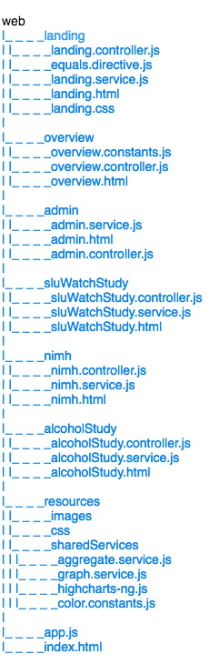
File System Hierarchy
Previous Implementation
Current Implementation
Makes development easy
S.O.L.I.D
Monolithic vs Modular Approach
Notes:
At first everything was in one folder – even for MTD
mAAS has all the html, css, php,js in one .php file, no separation of entities
Single Responsibility Principle
File system diagram
Every module
stress on shared services( service oriented architecture)
dependency injection
Provides separation of concerns which means easy to test, easy to build, dependency injection among shared modules

Slide 21
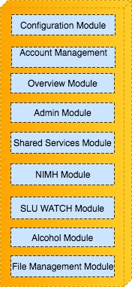
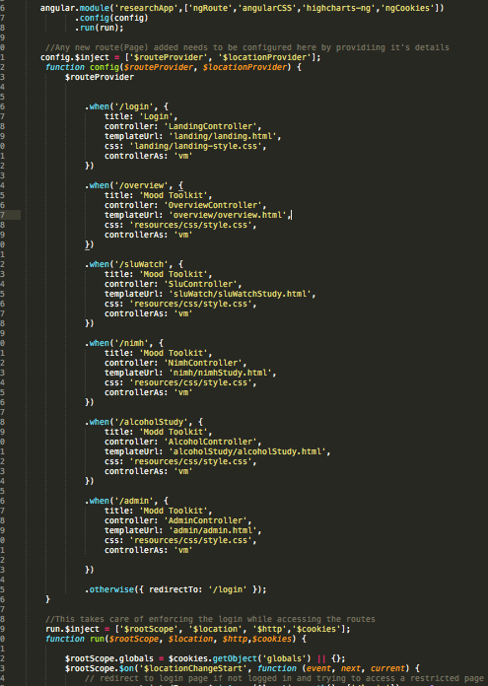
Configuration Module
Webpack
App.js
Config.php
Amazon ec-2
Notes:
Webpack loads all the dependencies and cdn’s take care of the app settings, brings in testing framework ( Karma)
App.js
Loads the app
defines the modules
Configures the modules ( controller, css, template, path)
uses a an angular service called routeProvider
defines the routes
runs the app
checks for globals and controls the cookies
Index.html
loads the ng-view directive which in turn runs the app
Config.php
Database connections
Database functionality
AWS hosting setup
sftp pulg-ins
apache and php.ini set up
Using aws allows scale up and scale down features

Slide 22
Account Management Module
Login
Register
E-mail confirmation
Notes:
Account management Module
-- login
-- register
different fields
FNAME
LNAME
Username
PASSWORD
confirm
Affiliation
2 different end points. Writing to 1 table “ userINFO “
check cookies and also restrict access. Cannot URL hack into a module without being logged in
Secure SHA512 algorithm for encryption and using a salt to make it much stronger. Not text input or storing password on a file
DB approach for login thus building a secure approach for login

Slide 23
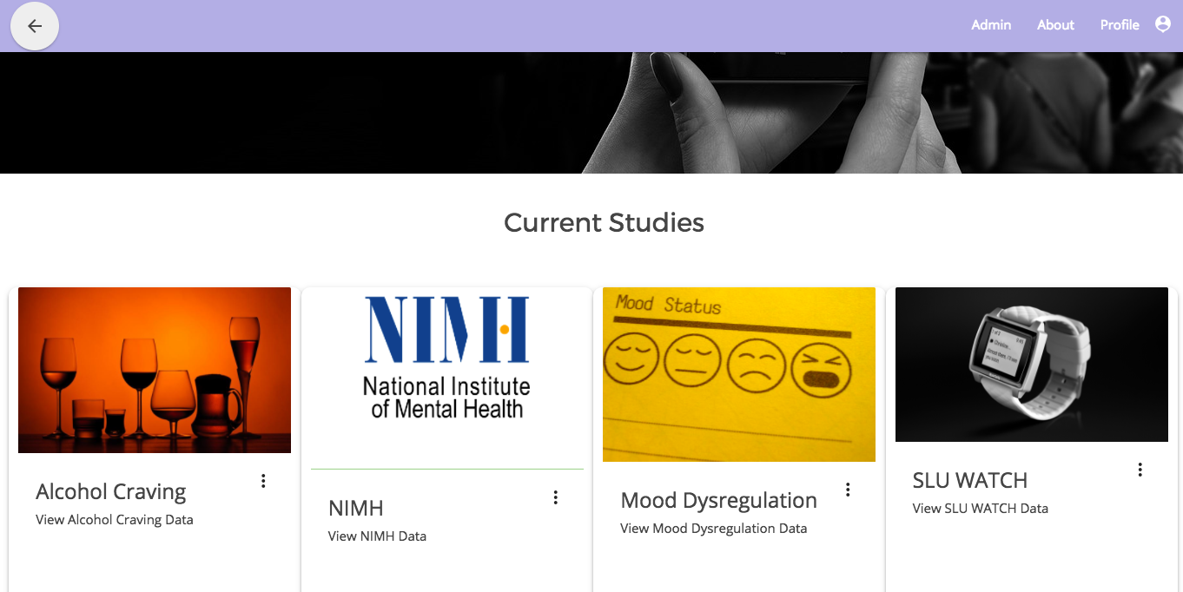
Overview Module
Landing Page
Provides interface for every other module

Slide 24
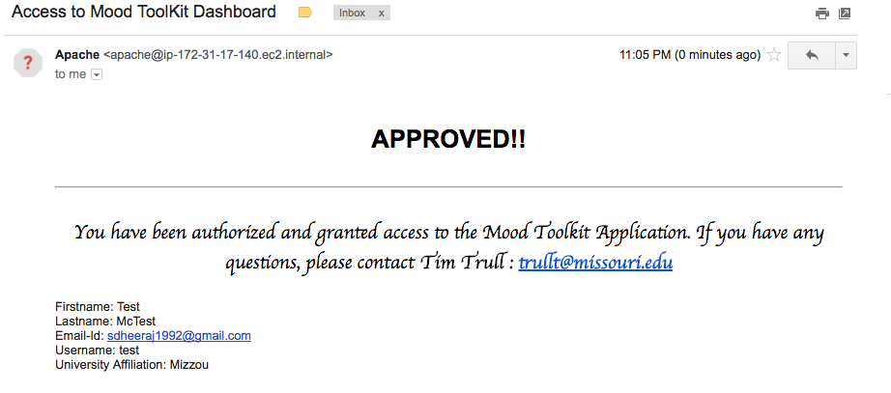
Admin Module
Show Users
Approved
Current
Provide Access
Revoke Access
RESTful end - points
E-mail confirmation
Notes:
Show users and their details based on whether or not approved. Easy to decide for the admin.
Includes email communication when approved.
Keeps track of who is using/ viewing these kind of sensitive data. Non trivial.
Double checking.
A good framework for permission oriented access, not everyone wants to see every data
Communicates with LoginService to check “ifAdmin”, else no access this module.
3 end points
ApproveUsers
GetUsers
DeleteUsers

Slide 25
Shared Services Module
Shared components
Highcharts-ng ( directive for drawing graphs via angular)
GraphService ( for drawing similar study graphs)
AggregateService ( for performing similar aggregations)
LoginService ( to allow user actions across whole app)
PHP Helper files shared in back-end
Services for each study module
Notes:
Shared services can be
across the app
across a module
depending upon where the functionality was it was residing there
Ideally controller should only manipulate the data, any other requests and response handling should always be done via services, provides a layer provides a layer abstraction
Helps development( debugging and testing), adds expendability,
Explain how highcharts-ng works: Open source code, which had to be integrated to work with MTD.
Html -→ just like any other directive ( title, p, a, div… similarly highcharts was also created because of this)
JS → just create a config file based on specification and properties in Highcharts.com and then pass the object around to services or template
graphService → Set of functions for drawing different graphs
aggregateService -> set of functions for doing aggregations in controllers
loginService -> Takes care of the login module
PHP -> database operations, config, python csv to mysql converter ( open source)

Slide 26
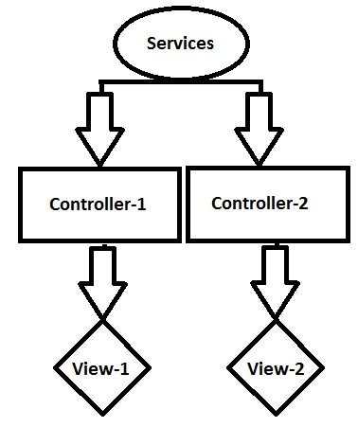
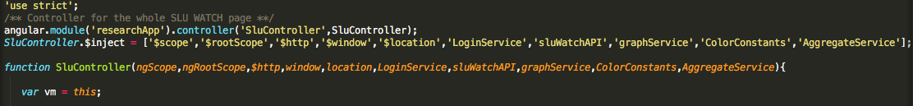
AngularJS Service Oriented Implementation
Service Oriented Architecture
Supports abstraction
Provides Dependency Injection
Ultimately encourages code re-use
Notes:
this is the implementation of SEPARATION OF CONCERNS
In the example snippet SLUController is being injected with many dependencies and

Slide 27
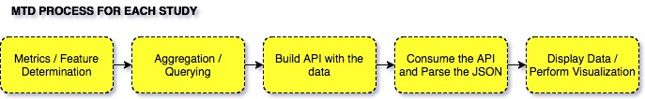
Study Modules
Survey Schema Generalization
Hierarchical Visualization
Study Overview
Participant
Process followed for each study
Notes:
application components / features are determined across all the studies ( metrics , stats , graph types)
Identifying shared components so that development is streamlined and easy
Implement these modules and then independent modules
Maintaining consistency on such level makes app more understandable ( self explanatory) – As mentioned Structure of dashboard was a major consideration
2 levels of visual display – allows the app to be more informative, data is well spread as well as , well aggregated by doing this.
Discuss the requirements( which features are needed, what they denote, how to be displayed, how to be calculated)
Do the querying and

Slide 28
NIMH STUDY
Database Table
5200+ records of survey data
148 features
33 participants
Stats studied for displaying
Days In study, Compliance, Survey Count
Mood Change Response ( Positive, Negative, Total)
Cause for Mood Change
DATE functions and Aggregate Functions for querying
Caching of JSON response helped improve network transit by 60%
Notes:
Compliance was average over the study and as well as user level.
SQL functions had to be optimized and queries. Grouping date related queries in one query helped a lot as unnecessary functions hit the db server
Using inbuilt PHP functions to parse and build a response object in JSON which was structured.
Initially, relay of this object across the http request had a lot of delay, thus an alternate approach of using writing the response to a cached json file and updating the file by periodically running the PHP scripts helped reduce the time of transfer by 60%. This was a vital design consideration which affects the running of the application in a positive manner.

Slide 29
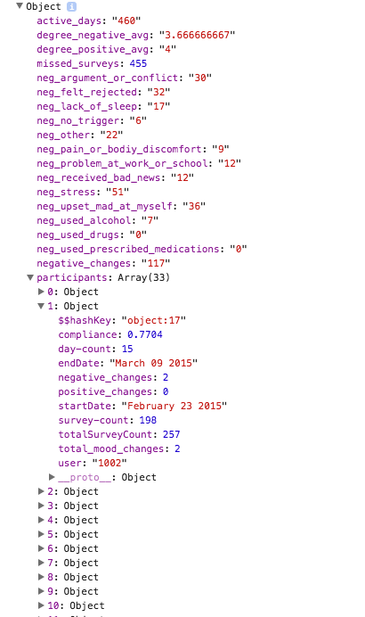
NIMH STUDY (contd.)
JSON parsed in the controller
Build the view
All the participants listed with respective files for download
Notes:
Look at the structured JSON response, helps parse it in the front end well.

Slide 30
SLU WATCH Study
31 participants ( Sensor and Survey)
722,731 records with 124 columns
Larger data = More metrics
Original sampling 1 row /s, sluWatch Table 1 row/min, sluWatchStats 1 row/day reduced to 756 rows
SQL Performance Considerations
Notes:
Give overview / reminder of SLU Watch Basis Study
756 rows for 31 participants, that is approx 25days for each. This is easily verified by the graph accurately.
1. Querying in a way to group by dates meant the query execution was longer, but grouping the fields by user and then by day and then by hour gave quicker results
2. sluWatchStats had aggregated records for all the values making querying easier
3. Thus, indexing the table by the participant and then by the Dates made query execution extremely quicker, for example the queries to get the daily and hourly physiological data individually took about 3-5s, after indexing it came down to around 750ms, that is a roughly 400% decrease in SQL execution time

Slide 31
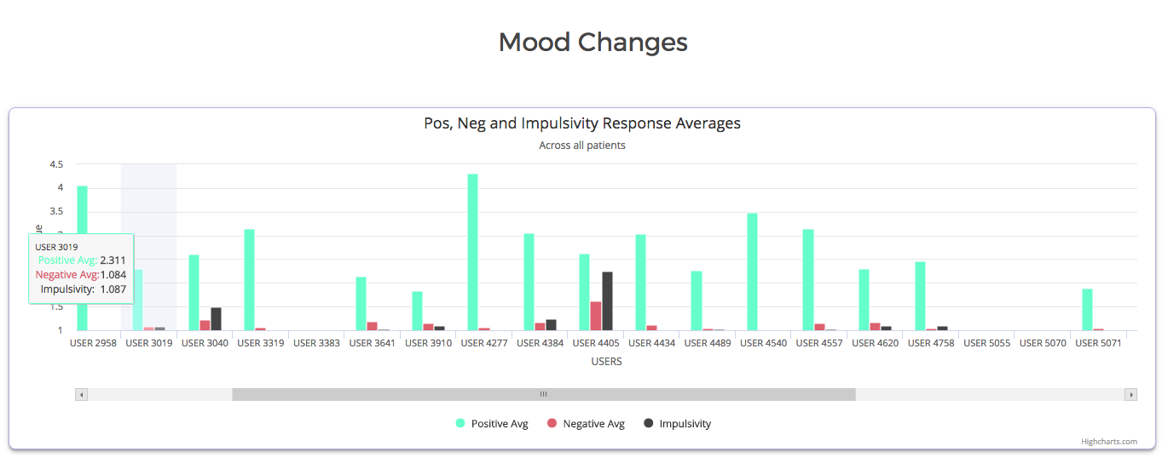
SLU WATCH (contd.)
Separate by Daily and Hourly Metrics
Feed array/ list of values to highcharts object
Divide the JSON response into study level and user level
Files zipped for each participants available for download

Slide 32
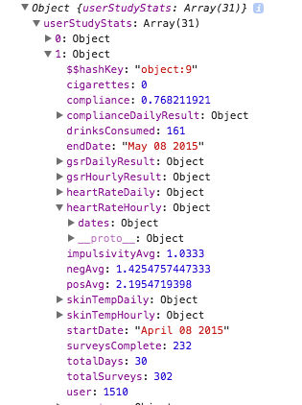
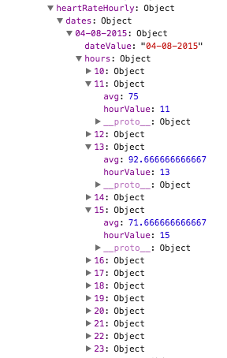
SLU WATCH
JSON RESPONSE STRUCTURE
Example
USER 1510
Notes:
Compliance – (Study Level, participant, For each day in study for every participant)
Days in study
Average response for mood change
positive, negative and impulsivity
Physiological Stats for each participant
GSR – Galvin Skin Response – measured in (μS)
Heart Rate – measured in bpm
Skin Temperature – measured in °F
Substance consumption stats ( cigarettes and drink)
Average usage of substance / participant
Total quantity of consumption for each participant.

Slide 33
ALCOHOL CRAVING STUDY
Similar Questionnaire as NIMH
Lot of common features and similar metrics being studied
Thus, fastest development among the three
13,164 survey records with 192 columns for 24 participants
Overview has users listed with file download and user view link
Notes:
The schema was almost similar to the one in NIMH but the number of participants and the data collected differed, which meant making changes to the API development.
This is where the survey schema generalization came in very handy, the common features and the similarity of metrics being studied made the implementation of this module the quickest among all the three study modules.
The queries changed as column names and table structure changed
Heirarchical view shown along with

Slide 34
FILE MANAGEMENT MODULE
FILE structure based off studies and then sub folders for participants
Incorporated zipping functionality zipHelper.php
Recursive design which can be extended
Easy access rather than individual download
Notes:
Previously was zipped and then placed on server, bad design practice
zipHelper.php ----→ (PHP classes ZipArchive and DirectoryIterator)
All the individual raw survey files can be converted to a single zip.
Can work for a directory, a file etc
Needs to be passed correct locations for it to be run
Placed inside a cron job

Slide 35
DEMO
Screenshots or demo or video recording for 1 minute

Slide 37
OUTLINE
Introduction
Related Work
Data Overview
Methodology & Implementation
Results
Conclusion

Slide 38
RESULTS
Secure Application – Registration, Password & Approval based
File Systems ( Monolithic vs Modular)
Previous text files to Graphical UI ( Rich Graphs via Highcharts.js)
3 times faster loading with additional studies
Reliable due to AWS hosting
Unit testing
Successful Implementation of multi level hierarchy for Disparate datasets
Notes:
Compare timings
File systems
Monolithic vs heterogeneous approach (modular)
Passwords secure + 2 level authorization
Txt files vs graphs
Multi level hierarchy for disparate datasets
Reliable(ec-2) also scalable
Unit testing ( a good way to test separate features, provided by AngularJS)

Slide 39
OUTLINE
Introduction
Related Work
Data Overview
Methodology & Implementation
Results
Conclusion

Slide 40
CONCLUSION
MTD - A full stack application development approach for a modular mutli-page app
Enriching process with current industry standards
Helpful for research community
Appropriate usage of Survey and Sensor Data
FUTURE WORK
More robust Unit Testing
Highstocks.js for time series graphs
Restrictive access based on permissions
More Studies
Notes:
1. This project encapsulates the full stack development methodology in developing modular multi page web applications for large data sets
2. has involved using some of the newest and popular web development technologies [6] [10], handling large datasets in terms of relational databases and reducing query complexities, all of which has been an enriching process in terms of knowledge gained about web applications architecture and dashboard development.
3. Extensible by adding more studies, requires code change but not too much
4. Helpful for research community ( state tim and ryan interest)
Future work
- More robust unit testing, highstock and restrictive access based on permissions and of course more studies.

Slide 41

Slideshow credits

Slide 42

Thank You!
Questions?

